Slide 1
TIME VALUE OF MONEY

Slide 2
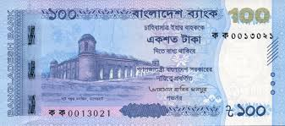

Slide 3
The concept of the time value of money (TVM) revolves around the principle that a sum of money available today holds greater value than the identical amount received in the future, primarily because of its ability to generate earnings over time. This fundamental financial idea asserts that, as long as money can accrue interest, receiving funds earlier is always more advantageous.
Understanding TVM is crucial in financial decision-making. It serves as a vital tool for evaluating different investment options and addressing financial challenges related to borrowing, leasing, and saving strategies

Slide 4
The Time Value of Money (TVM) concept helps us understand how the worth of money changes over time when invested.
As time progresses, the value of funds invested in any project or business fluctuates.
To determine the current worth of that money, we use a specific mathematical formula.
This formula calculates the present value by factoring in the element of time, showing how money's value evolves.

Slide 5
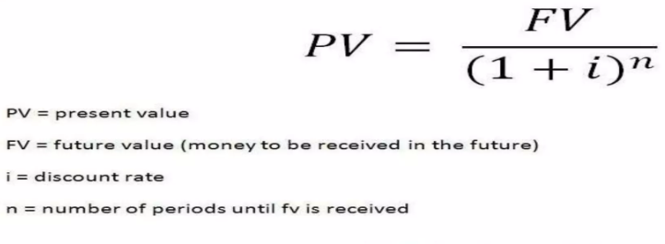
What is the present value (PV) of $100 due in 3 years, if I/YR = 4%?

Slide 6
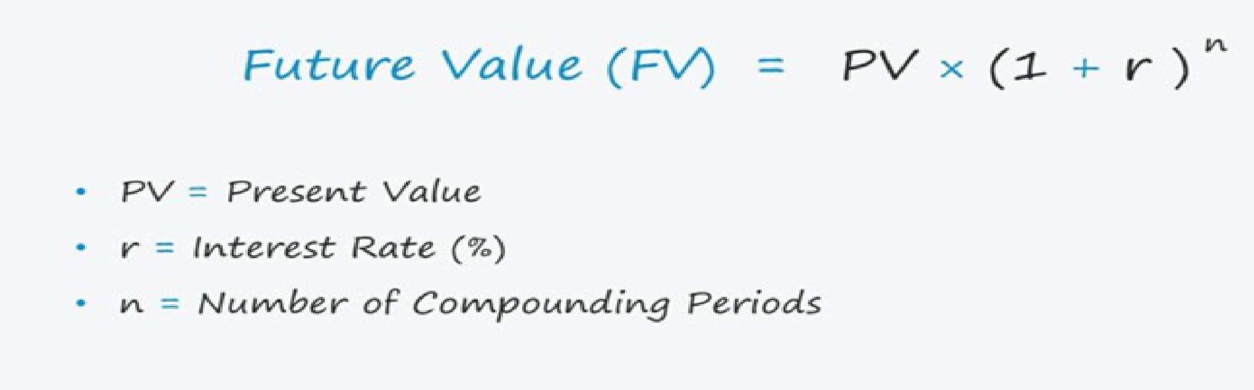

Slide 7
Why Money Has a Time Value
Several factors explain why money today is worth more than the same amount in the future:
Risk and Uncertainty – The future is inherently unpredictable. While we control cash outflows like payments, the timing and amount of future cash inflows remain uncertain, introducing risk that affects money's value over time.
Inflation – In an economy experiencing inflation, money received now has greater purchasing power than money received later. Simply put, a rupee in hand today can buy more goods and services than a rupee received in the future.

Slide 8
3.Consumption: People typically favor spending money now rather than postponing consumption to the future.
4.Investment Opportunity: Investment options allow individuals to use funds received today to earn greater returns at a later date.
For example, if someone must choose between receiving Rs.10,000 immediately or after one year, they usually opt for the immediate payment.
This preference exists because the purchasing power of Rs.10,000 today is generally higher than what the same amount will buy a year from now.

Slide 9
Time value of money (TVM) is important?
Businesses employ the Time Value of Money concept in multiple ways to make definitive choices about capital investments and to select among alternative projects. Two widely used approaches are the Net Present Value (NPV) method and the Internal Rate of Return (IRR) technique.
With the NPV approach, you calculate the sum of the present values of all cash inflows and outflows related to a project. A positive total indicates that the project is financially viable and should be pursued.
The IRR method involves identifying the discount rate that equates the present value of expected future cash flows to the initial investment cost. If this internal rate of return exceeds the company’s required discount rate, the project is considered worthwhile. Generally, a higher IRR signals a more attractive investment opportunity.

Slide 10
Techniques of time value of money
There are two primary approaches to managing the time value of money:
Compounding (Future Value) Method This technique involves determining the future worth of cash flows. It works by adding the interest earned on the original principal back into the principal at the end of each compounding period, allowing the investment to grow exponentially over time.
Discounting (Present Value) Method This approach calculates the current value of future cash flows by reversing the compounding process, effectively determining what those future amounts are worth in today’s terms.

Slide 11
Methods of calculating future value
Compounding: This refers to the technique of determining the future worth of cash flows by utilizing compound interest principles.
Compound Interest: This type of interest accumulates not only on the initial principal but also on the interest that has been earned and retained from previous periods.
Simple Interest: This interest is calculated solely on the original principal amount, meaning no interest is earned on previously accrued interest.

Slide 12
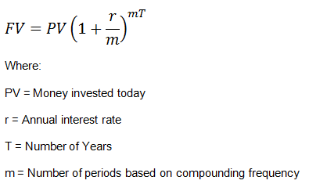

Slide 13
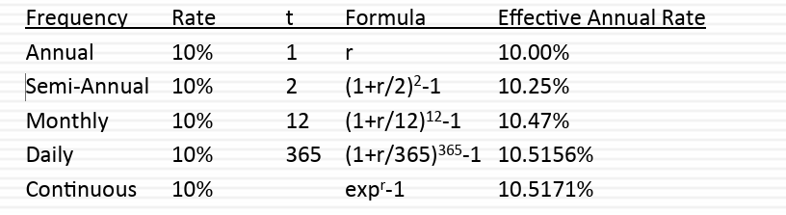
The Frequency of Compounding
The frequency of compounding affects the future and present values of cash flows. The stated interest rate can deviate significantly from the true interest rate – ¤
For instance, a 10% annual interest rate, if there is semiannual compounding, works out to- Effective Interest Rate = 1.052 - 1 = .10125 or 10.25%

Slide 14
Types of Cashflows
• Simple cash flows,
• Annuities,
• Growing annuities
• Perpetuities and
• Growing perpetuities

Slide 15
TVM based on lumpsum Vs Installment/Annuity/Cashflow
Total lumpsum of BDT 100 investment today for next 2 years @ 10% simple rate
BDT100 lumpsum due in 2 years
0
10%
1
2
100
Total lumpsum of BDT 100 investment every year for next 3 years @ 10% simple rate
3-year BDT100 ordinary annuity
0
1
2
3
10%
100
100
100

Slide 16
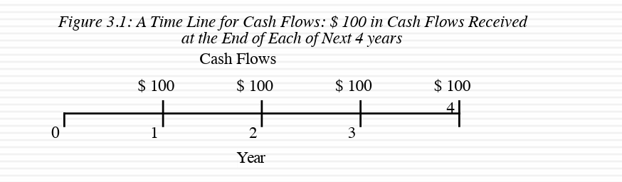
Time lines for cash flows/Annuity
The best way to visualize cash flows is on a time line, where you list out how much you get and when. ¨
In a time line, today is specified as “time 0” and each year is shown as a period.

Slide 17
Uneven Cashflow/Annuity/Installment
Uneven cash flow stream
0
1
2
3
4
4%
100
300
300
-50

Slide 18
What is the PV of this uneven cash flow stream?
0
1
2
3
4
4%
100
300
300
-50
96.15
277.37
266.70
-42.74
597.48 = PV

Slide 19
What is the difference between an ordinary annuity and an annuity due?
Ordinary Annuity
0
1
2
3
I%
PMT
PMT
PMT
Annuity Due
0
1
2
3
I%
PMT
PMT
PMT

Slide 20
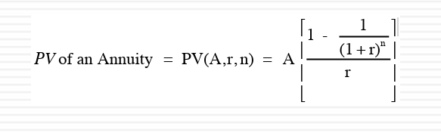
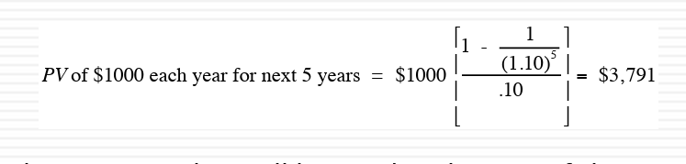
Present value of an annuity
Example: The present value of an annuity of $1,000 at the end of each year for the next five years, assuming a discount rate of 10% is -

Slide 21
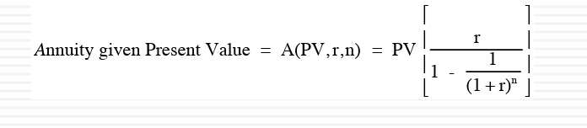
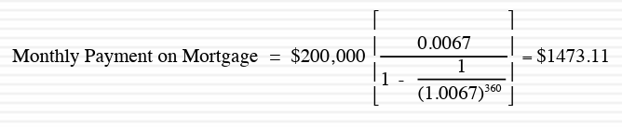
Annuity, given Present Value
Example: Suppose you borrow $200,000 to buy a house on a 30-year mortgage with monthly payments. The annual percentage rate on the loan is 8%. The monthly payments on this loan, with the payments occurring at the end of each month, can be calculated using this equation on:

Slide 22
Present value of an annuity due
PVA_{due} = PVA_{ord}(1 + I)
PVA_{ord} = PV of Ordinary Annuity
I = Interest rate
Referring last example:
PVA_{due} = $3791 X 1.1 = $4170.10

Slide 23
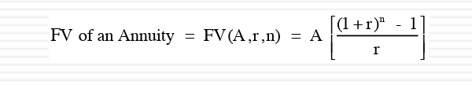
Future value of an annuity
This is the equation on you would use to determine how much money you will accumulate at a future point in me if you set aside a constant amount each period.

Slide 24
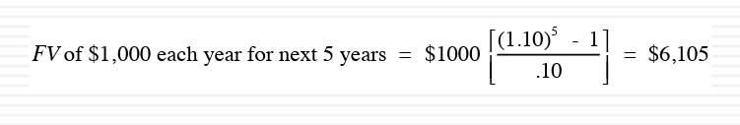
Example
Thus, the future value of $1,000 at the end of each year for the next five years, at the end of the fi h year is (assuming a 10% discount rate) -

Slide 25
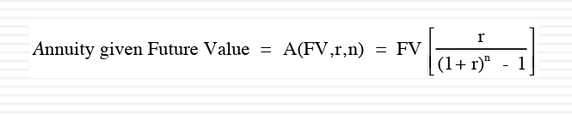
Annuity, given Future Value

Slide 26
Future value of an annuity due
FVA_{due} = FVA_{ord}(1 + I)
FVA_{ord} = FV of Ordinary Annuity
I = Interest rate
Referring last example:
FVA_{due} = $6105 X 1.1 = $6715.50

Slide 27
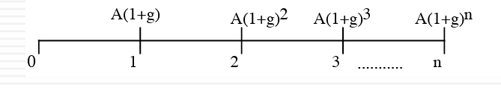
Growing Annuity
A growing annuity is a cash flow growing at a constant rate for a specified period of me. If A is the current cash flow, and g is the expected growth rate, the me line for a growing annuity looks as follows –

Slide 28
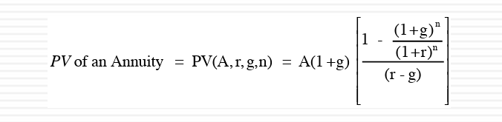
Present Value of a Growing Annuity

Slide 29
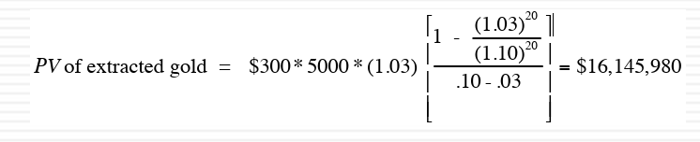
Example: The Value of a Gold Mine
Consider the example of a gold mine, where you have the rights to the mine for the next 20 years, over which period you plan to extract 5,000 ounces of gold every year. The price per ounce is $300 currently, but it is expected to increase 3% a year. The appropriate discount rate is 10%. The present value of the gold that will be extracted from this mine can be estimated as follows –

Slide 30
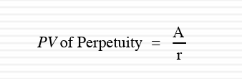
Perpetuity
A perpetuity is a constant cash flow at regular intervals forever . The present value of a perpetuity is-

Slide 31
Example: Valuing a Console Bond
A console bond is a bond that has no maturity and pays a fixed coupon. Assume that you have a 6% coupon console bond. The value of this bond, if the interest rate is 9%, is as follows -
Value of Console Bond = $60 / .09 = $667

Slide 32
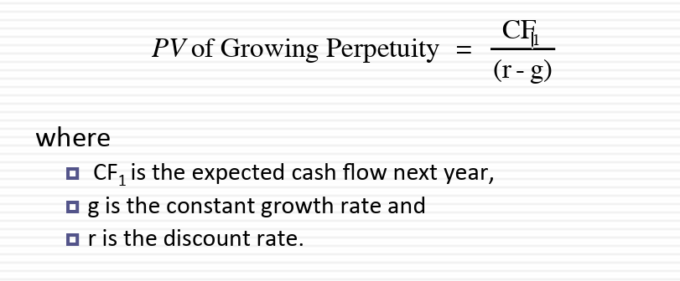
Growing Perpetuities
A growing perpetuity is a cash flow that is expected to grow at a constant rate forever. The present value of a growing perpetuity is -

Slide 33
#1 Problem
A 20-year-old student wants to save $5 a day for her retirement. Every day she places $5 in a drawer. At the end of the year, she invests the accumulated savings ($1,825) in a brokerage account with an expected annual return of 8%.
If you don’t start saving until you are 40 years old, how much will you have at 65?
2. How much must the 40-year old deposit annually to catch the 20-year old?

Slide 34
#2 Problem
Assume that you want to send your newborn child to a private college (when he gets to be 18 years old). The tui on costs are $ 16000/year now and that these costs are expected to rise 5% a year for the next 18 years. Assume that you can invest, a er taxes, at 8%.

